Slide 1




01
BANK CUSTOMER SEGMENTATION

Slide 2
INTRODUCTION
Introduction
This project focuses on analyzing bank customer transaction data using Microsoft Excel. The dataset includes customer and transaction details such as transaction type, amount, and balance. Customer segmentation helps banks understand customer behavior and improve services.
Objectives
• To analyze bank customer transaction data • To segment customers based on transaction behavior • To identify high, medium, and low activity customers • To support data-driven banking decisions
Scope of the Study
The study is limited to the analysis of the given Excel dataset using Excel tools such as sorting, filtering, formulas, and pivot tables.
Methodology
1. Collection of bank transaction data 2. Data cleaning and formatting in Excel 3. Use of formulas and pivot tables 4. Customer segmentation 5. Interpretation of results

Slide 3
TransactionID | CustomerID | CustomerDOB | CustGender | CustLocation | CustAccountBalance | TransactionDate | TransactionTime | TransactionAmount (INR)
T1 | C5841053 | 10-01-1994 | F | JAMSHEDPUR | 17819.05 | 02-08-2016 | 143207 | 25
T2 | C2142763 | 04-04-1957 | M | JHAJJAR | 2270.69 | 02-08-2016 | 141858 | 27999
T3 | C4417068 | 26-11-1996 | F | MUMBAI | 17874.44 | 02-08-2016 | 142712 | 459
T4 | C5342380 | 14-09-1973 | F | MUMBAI | 866503.2 | 02-08-2016 | 142714 | 2060
T5 | C9031234 | 24-03-1988 | F | NAVI MUMBAI | 6714.43 | 02-08-2016 | 181156 | 1762.5
T6 | C1536588 | 08-10-1972 | F | ITANAGAR | 53609.2 | 02-08-2016 | 173940 | 676
T7 | C7126560 | 26-01-1992 | F | MUMBAI | 973.46 | 02-08-2016 | 173806 | 566
T8 | C1220223 | 27-01-1982 | M | MUMBAI | 95075.54 | 02-08-2016 | 170537 | 148
T9 | C8536061 | 19-04-1988 | F | GURGAON | 14906.96 | 02-08-2016 | 192825 | 833
T10 | C6638934 | 22-06-1984 | M | MUMBAI | 4279.22 | 02-08-2016 | 192446 | 289.11
T11 | C5430833 | 22-07-1982 | M | MOHALI | 48429.49 | 02-08-2016 | 204133 | 259
T12 | C6939838 | 07-07-1988 | M | GUNTUR | 14613.46 | 02-08-2016 | 205108 | 202
T13 | C6339347 | 13-06-1978 | M | AHMEDABAD | 32274.78 | 02-08-2016 | 203834 | 12300
T14 | C8327851 | 05-01-1992 | F | THANE | 59950.44 | 01-08-2016 | 84706 | 50
T15 | C7917151 | 24-03-1978 | M | PUNE | 10100.84 | 01-08-2016 | 82253 | 338
T16 | C8334633 | 10-07-1968 | F | NEW DELHI | 1283.12 | 01-08-2016 | 125725 | 250
T17 | C1376215 | 1/1/1800 | M | MUMBAI | 77495.15 | 01-08-2016 | 124727 | 1423.11
T18 | C8967349 | 16-07-1989 | M | MUMBAI | 2177.85 | 01-08-2016 | 124734 | 54
T19 | C3732016 | 11-01-1991 | M | MUMBAI | 32816.17 | 01-08-2016 | 122135 | 315
T20 | C8999019 | 24-06-1985 | M | PUNE | 10643.5 | 01-08-2016 | 152821 | 945
T21 | C6121429 | 20-04-1993 | M | NO 3 KALYANI NAGAR PUNE | 2934.22 | 01-08-2016 | 152824 | 36
T22 | C4511244 | 31-08-1989 | F | SECUNDERABAD | 4470.15 | 03-08-2016 | 105329 | 27
T23 | C7018081 | 1/1/1800 | M | WAYS PANCHKUVA AHMEDABAD | 143.07 | 03-08-2016 | 104718 | 110
T24 | C5830215 | 01-10-1986 | M | LUCKNOW | 12868.42 | 03-08-2016 | 125629 | 291
T25 | C1219943 | 17-05-1991 | F | GURGAON | 2951.1 | 03-08-2016 | 124834 | 1892
T26 | C5521085 | 24-02-1993 | M | GURGAON | 3297.74 | 03-08-2016 | 160533 | 242
T27 | C5430368 | 01-02-1986 | M | DELHI | 285.76 | 03-08-2016 | 160537 | 5500
T28 | C2416848 | 01-04-1993 | M | CHENNAI | 20986.66 | 03-08-2016 | 160544 | 2235
T29 | C7935438 | 1/1/1800 | M | MOHALI | 969436.1 | 03-08-2016 | 183634 | 36.9
TransactionID | CustomerID | CustomerDOB | CustGender | CustLocation | CustAccountBalance | TransactionDate | TransactionTime | TransactionAmount (INR)
T1 | C5841053 | 10-01-1994 | F | JAMSHEDPUR | 17819.05 | 02-08-2016 | 143207 | 25
T2 | C2142763 | 04-04-1957 | M | JHAJJAR | 2270.69 | 02-08-2016 | 141858 | 27999
T3 | C4417068 | 26-11-1996 | F | MUMBAI | 17874.44 | 02-08-2016 | 142712 | 459
T4 | C5342380 | 14-09-1973 | F | MUMBAI | 866503.2 | 02-08-2016 | 142714 | 2060
T5 | C9031234 | 24-03-1988 | F | NAVI MUMBAI | 6714.43 | 02-08-2016 | 181156 | 1762.5
T6 | C1536588 | 08-10-1972 | F | ITANAGAR | 53609.2 | 02-08-2016 | 173940 | 676
T7 | C7126560 | 26-01-1992 | F | MUMBAI | 973.46 | 02-08-2016 | 173806 | 566
T8 | C1220223 | 27-01-1982 | M | MUMBAI | 95075.54 | 02-08-2016 | 170537 | 148
T9 | C8536061 | 19-04-1988 | F | GURGAON | 14906.96 | 02-08-2016 | 192825 | 833
T10 | C6638934 | 22-06-1984 | M | MUMBAI | 4279.22 | 02-08-2016 | 192446 | 289.11
T11 | C5430833 | 22-07-1982 | M | MOHALI | 48429.49 | 02-08-2016 | 204133 | 259
T12 | C6939838 | 07-07-1988 | M | GUNTUR | 14613.46 | 02-08-2016 | 205108 | 202
T13 | C6339347 | 13-06-1978 | M | AHMEDABAD | 32274.78 | 02-08-2016 | 203834 | 12300
T14 | C8327851 | 05-01-1992 | F | THANE | 59950.44 | 01-08-2016 | 84706 | 50
T15 | C7917151 | 24-03-1978 | M | PUNE | 10100.84 | 01-08-2016 | 82253 | 338
T16 | C8334633 | 10-07-1968 | F | NEW DELHI | 1283.12 | 01-08-2016 | 125725 | 250
T17 | C1376215 | 1/1/1800 | M | MUMBAI | 77495.15 | 01-08-2016 | 124727 | 1423.11
T18 | C8967349 | 16-07-1989 | M | MUMBAI | 2177.85 | 01-08-2016 | 124734 | 54
T19 | C3732016 | 11-01-1991 | M | MUMBAI | 32816.17 | 01-08-2016 | 122135 | 315
T20 | C8999019 | 24-06-1985 | M | PUNE | 10643.5 | 01-08-2016 | 152821 | 945
T21 | C6121429 | 20-04-1993 | M | NO 3 KALYANI NAGAR PUNE | 2934.22 | 01-08-2016 | 152824 | 36
T22 | C4511244 | 31-08-1989 | F | SECUNDERABAD | 4470.15 | 03-08-2016 | 105329 | 27
T23 | C7018081 | 1/1/1800 | M | WAYS PANCHKUVA AHMEDABAD | 143.07 | 03-08-2016 | 104718 | 110
T24 | C5830215 | 01-10-1986 | M | LUCKNOW | 12868.42 | 03-08-2016 | 125629 | 291
T25 | C1219943 | 17-05-1991 | F | GURGAON | 2951.1 | 03-08-2016 | 124834 | 1892
T26 | C5521085 | 24-02-1993 | M | GURGAON | 3297.74 | 03-08-2016 | 160533 | 242
T27 | C5430368 | 01-02-1986 | M | DELHI | 285.76 | 03-08-2016 | 160537 | 5500
T28 | C2416848 | 01-04-1993 | M | CHENNAI | 20986.66 | 03-08-2016 | 160544 | 2235
T29 | C7935438 | 1/1/1800 | M | MOHALI | 969436.1 | 03-08-2016 | 183634 | 36.9

Slide 4
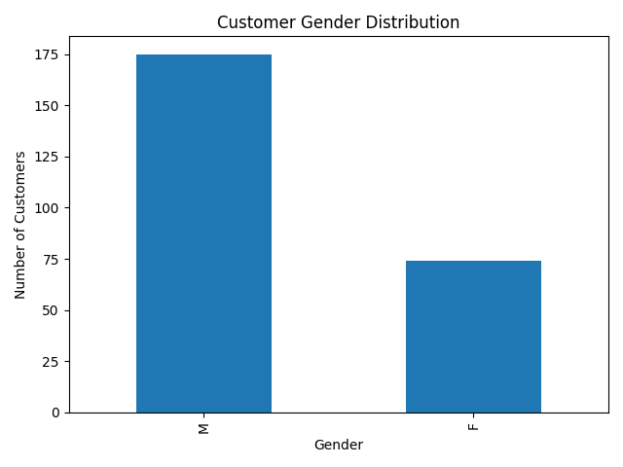
INTERPRETATION: shows the gender-wise distribution of bank customers. It helps in understanding the gender composition of customers for targeted services.

Slide 5
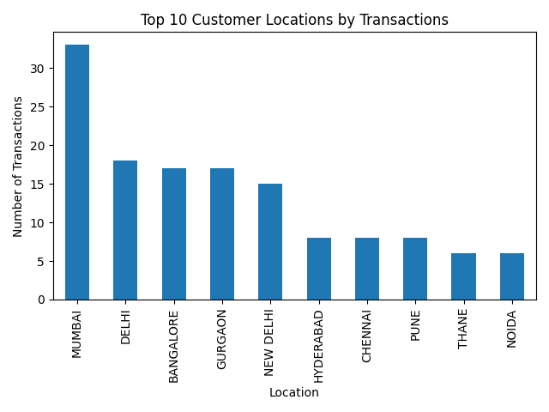
INTREPRETATION:
highlights the top 10 customer locations based on transaction count. These locations show higher customer engagement and banking activity

Slide 6
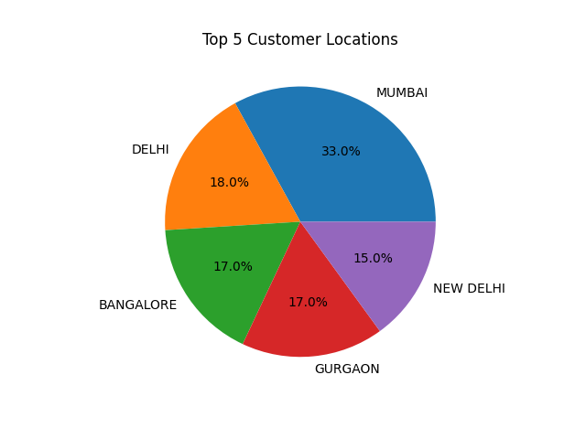
INTREPRETATION:
This chart represents the percentage contribution of the top five customer locations based on transaction count.

Slide 7
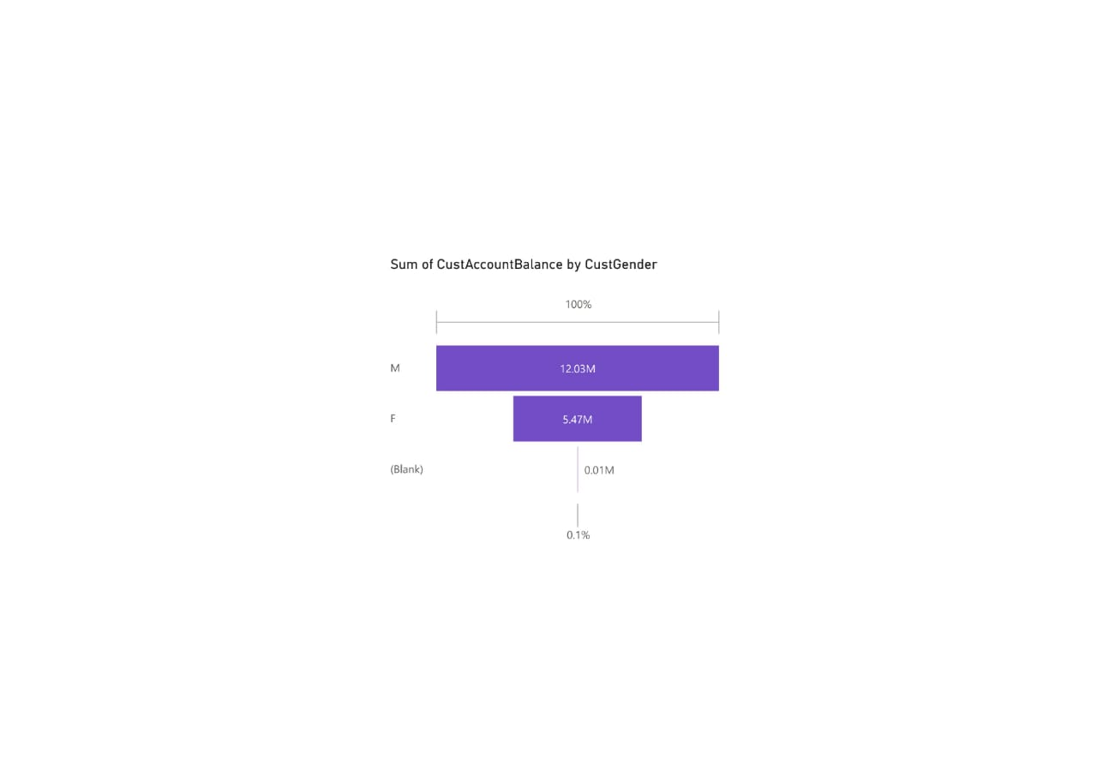
INTERPRETATION:
Male customers (M) hold the highest total account balance, approximately 12.03 million, contributing the major share (about 69%) of the overall balances.
Female customers (F) have a total balance of around 5.47 million, which is significantly lower than males, contributing roughly 31% of the total.
Blank/Unspecified gender accounts contribute a negligible amount (0.01 million, ~0.1%), indicating very few records with missing gender information.

Slide 8
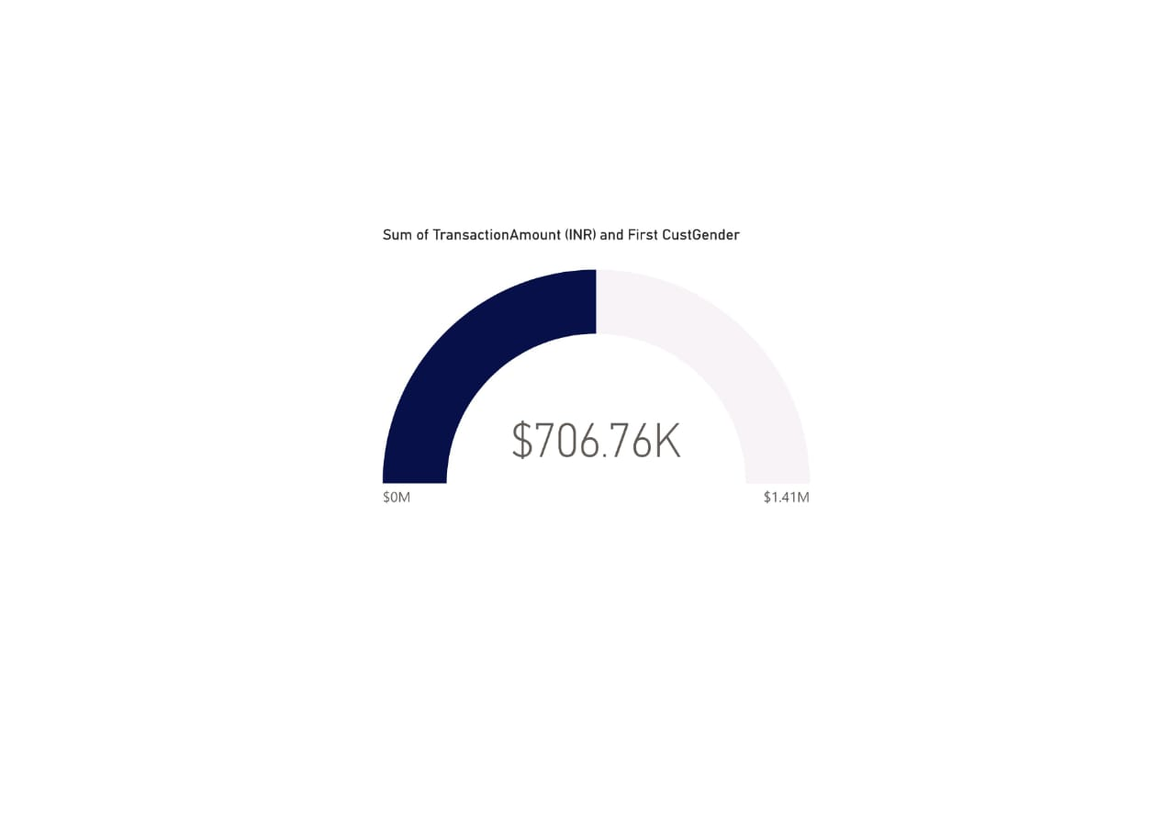
INTERPRETATION:
The gauge shows a total transaction amount of about 706.76K.
The scale ranges from 0 to 1.41M, and the current value is positioned at around 50% of the maximum.
This indicates that the current transaction amount represents a moderate level of overall transaction activity.
When viewed along with customer gender (First CustGender), it suggests that transactions from the analyzed gender group contribute roughly half of the total possible transaction volume.

Slide 9
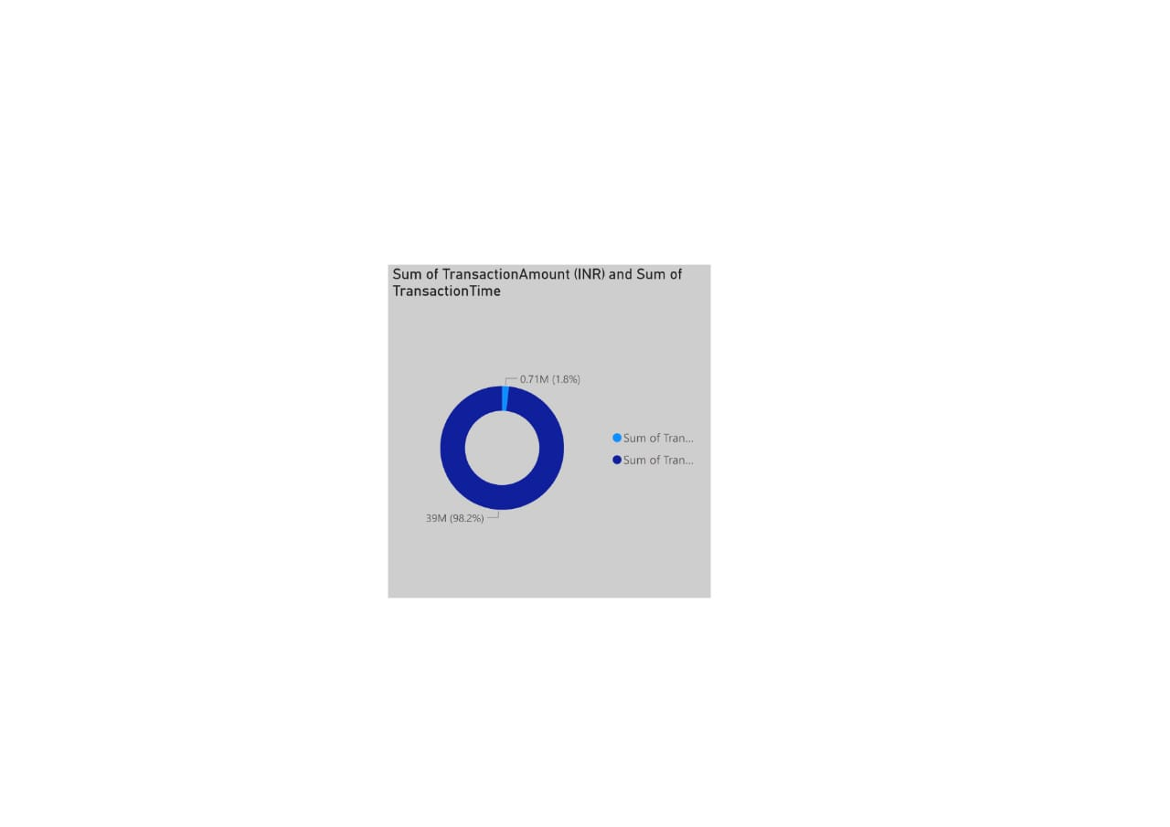
INTERPRETATION:
The Sum of Transaction Amount (INR) dominates the chart with approximately 39 million, contributing about 98.2% of the total.
The Sum of Transaction Time is very small in comparison, around 0.71 million, accounting for only 1.8%.

Slide 10

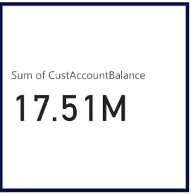
CUSTOMER DASHBOARD

Slide 11
CONCLUSION
This project successfully analyzed bank customer transaction data to understand customer behavior and segment customers based on their demographic details, transaction patterns, and account balances. By using data analysis and visualization tools such as Excel and Power BI, raw banking data was transformed into meaningful insights through charts, KPIs, and an interactive dashboard.
The analysis revealed that most customers perform low to medium value transactions and maintain moderate account balances, while a smaller group of customers holds high balances and contributes significantly to the bank’s overall value. Customer segmentation helped in identifying high-value customers who can be targeted with personalized services and retention strategies.
Overall, the dashboard provides a clear and effective decision-support system for banks. It helps management monitor customer trends, identify profitable segments, and improve customer satisfaction through data-driven decisions. This project demonstrates how data analytics can play a vital role in enhancing banking operations and strategic planning.

Slide 12



